Slide 1
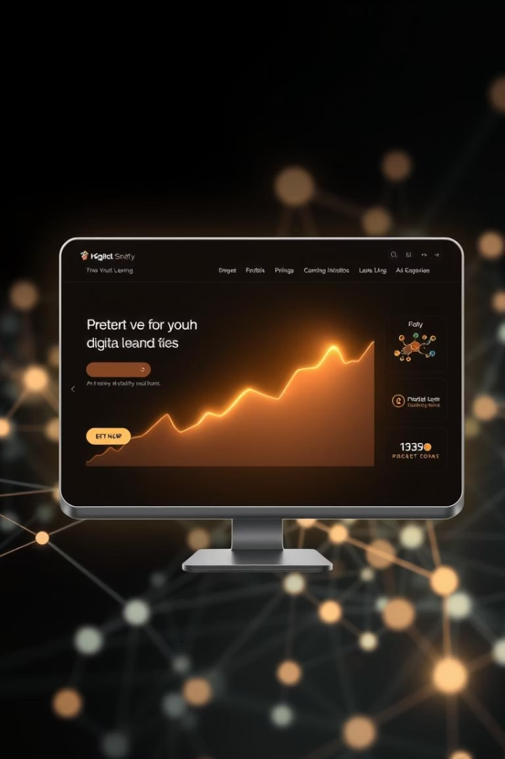

Building a Student Management System with Python
This presentation explores the development of a robust student management system using Python. We'll cover everything from database integration to building a user-friendly interface, providing a comprehensive guide for developers and students alike.
by Gangadhar

Slide 2




Core Components of the System
Database Management
User Interface
Backend Logic
Enable easy interaction for administrators and students.
Process data and manage system operations.
Store student, course, and grade data efficiently.
A student management system relies on three core components: a database for data storage, a user interface for interaction, and backend logic to drive functionality. Each component plays a crucial role in the system's overall performance and usability.

Slide 3
Choosing the Right Database
SQLite
PostgreSQL
Lightweight and embedded. Ideal for small applications.
Robust and scalable. Suitable for larger systems.
No separate server needed.
Client-server architecture.
File-based storage.
Advanced features and security.
Selecting the appropriate database is crucial. SQLite is excellent for quick prototypes or small-scale systems, while PostgreSQL offers scalability and advanced features for larger, more complex student management solutions.

Slide 4
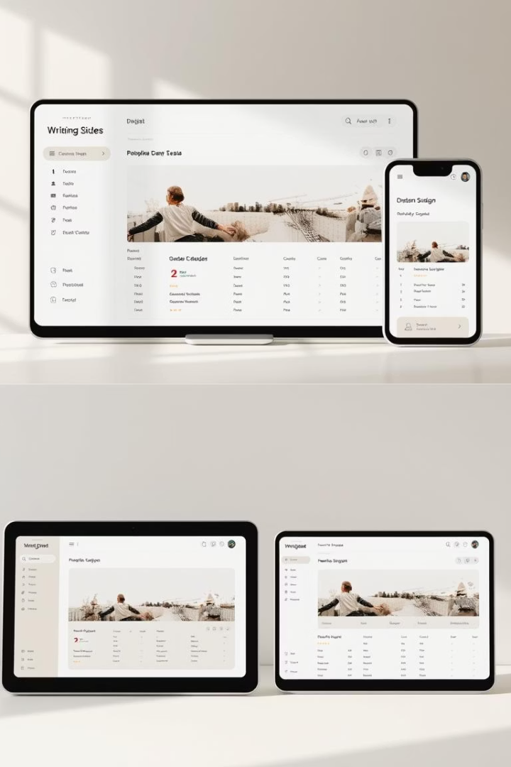
Designing the User Interface
Tkinter
PyQt
Python's standard GUI toolkit. Simple and built-in.
Powerful and cross-platform. Extensive widget library.
Django/Flask (Web)
For web-based interfaces. Flexible and scalable.
The user interface defines the system's accessibility. Tkinter offers a straightforward approach for desktop apps, PyQt provides advanced capabilities, and web frameworks like Django or Flask are perfect for browser-accessible systems.

Slide 5
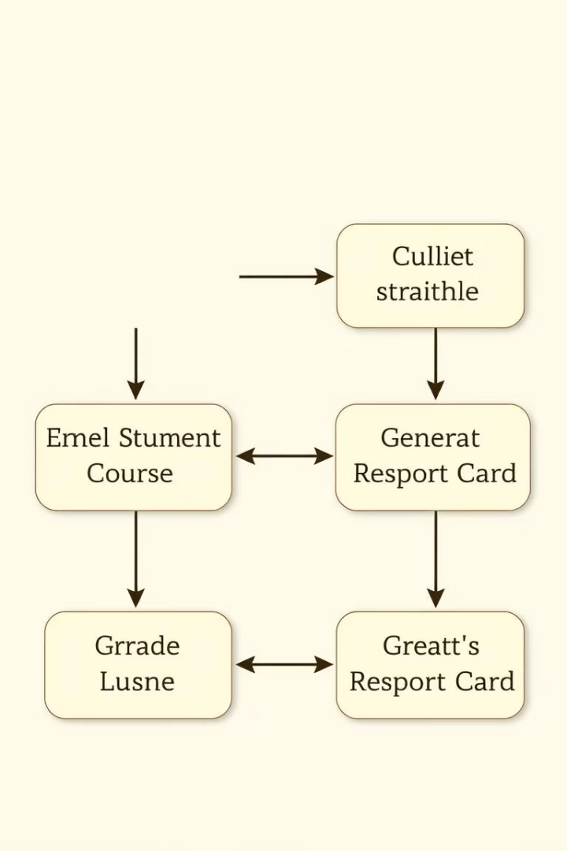
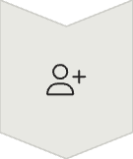



Implementing Key Features
Add/Remove Students
Manage student records.
Enroll in Courses
Assign students to courses.
Record Grades
Update academic performance.
Generate Reports
Retrieve data for analysis.
Key features include adding and removing student records, enrolling students in courses, recording and updating grades, and generating comprehensive reports. These functions form the backbone of any effective student management system.

Slide 6
Development Workflow
Plan & Design
1
Outline system architecture.
2
Database Setup
Create schema and tables.
Build Backend
3
Develop core logic.
4
UI Development
Design user interactions.
Testing & Debugging
5
Ensure functionality.
6
Deployment
Launch the system.
Our development workflow follows a structured timeline. Starting with detailed planning and design, we progress through database setup, backend and UI development, rigorous testing, and finally, deployment. This ensures a systematic and efficient build process.

Slide 7
Next Steps for Learning
Experiment with different UI frameworks.
Add more complex features like attendance tracking.
Explore advanced database queries.
Implement user authentication and roles.
To deepen your understanding, try integrating new UI frameworks or expanding features like attendance tracking. Delve into advanced database queries and implement robust user authentication. Continuous learning is key to mastery.

